Slide 1
Catholic Social Teaching
Principle: The Dignity of the Human Person

Slide 2
Dignity of the human person
The Catechism of the Catholic Church insists the
"dignity of the human person is rooted in his or her creation in the image and likeness of God." "All human beings," says the Church, "in as much as they are created in the image of God, have the dignity of a person.”¹

Slide 3
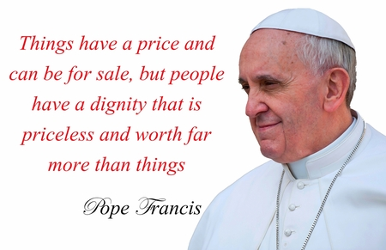

Slide 4
The principle of human dignity
Human dignity is foundational in understanding Catholic social teaching. Human dignity is established in the belief that all humans are created in the image and likeness of God.
All individuals have an intrinsic and immeasurable worth and dignity. Each human life, from conception to death, is sacred.
The principle of human dignity means that Catholic schools need to teach and promote the value that each person within our community is unique and has a God given dignity.
The principle of human dignity should be the starting point for all that the school board undertakes. Whilst this is an immense responsibility, it is not lived out in the abstract but rather in the small everyday actions of the school community made manifest in the policies, procedures and action of the board.

Slide 5
Points for reflection
As a school community we recognise that we don't always live up to the challenges presented in our understanding of the human person.
Frequently the human dignity or worth of individuals is obscured by the misuse of freedom, namely through sin. Sin is the refusal to accept and live according to God’s free gift of love.
As Matthew (25:37-40) makes clear, “the Lord of love meets us most of all in the persons of the poor, the sick and the forgotten.² Not only does sinfulness arise from the misuse of human freedom, it is also evident in the way it warps the structures of social living and inhibits human nourishing. Where injustice, poverty, and oppression prevail in any society, the dignity and worth of those living in it are undermined.” ³

Slide 6
Points for reflection
The school board is called to commit itself to ensuring that it upholds and promotes the dignity of all.
Where do you see this in the policies and procedures of the school?
Where else do you see the school upholding and promoting humanity dignity?
Are there any areas the board needs to improve on as a community to ensure it upholds and promotes human dignity?
Do any of school structures inhibit… “human nourishing”?
God created humankind in God’s image;
in the image of God, God created male and female - God created them.

Slide 7
References
Catechism of the Catholic Church 1994, nn 356 – 369.

